Slide 1
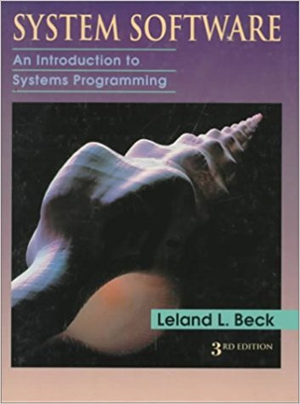
CSCI 30000 Systems Programming Course Project
TA: Tyler Phillips
phillity@iu.edu
MW 12:30-1:30 SL228

Slide 2
Course Project: Introduction
These slides will serve as a basic guide to help you get started on the course project
This project will take a considerable amount of time to complete successfully
If you have not already, please quickly make a plan with your group detailing how you will complete this project
There is no way you will be able to successfully complete this project if you put if off until the end of the semester
This project will enhance both your understanding of System Software and your skills as a programmer

Slide 3
Course Project: Goal
Design and Implementation Project: implement an assembler using Java, C++, Perl, Tcl/Tk, others (any one is OK)
I would suggest Java or Python, but you may choose whatever language reflects your team members’ strengths
Irrespective of choice, you will be responsible for clearly outlining the details of how to successfully compile and run your code
You will implement an assembler which can process SIC/XE assembly programs and generate the corresponding object codes and object programs

Slide 4
Course Project: Overview
You will implement an assembler which can process SIC/XE assembly programs and generate the corresponding object codes and object programs
What does this actually entail?
We will see some specific details in a few slides, but the overall challenge is to…
In homework one we saw how use an object code to calculate the corresponding SIC/XE instruction’s target addresses, addressing modes, opcode and instruction format (object code -> instruction details)
In this project you are tasked with discerning a SIC/XE program's instructions’ information and working to create the corresponding object codes (instruction details -> object code)

Slide 5
Course Project: First Steps
You need to start by reading the first two chapters of the textbook
Your ability to contribute to your team’s effort will be extremely limited if you have not read and fully understand the first two chapters of the textbook
These first two chapters outline many of the operations, considerations, data structures and implementation details that this project will require
I will give a few details here, but you will need to review the text to clearly understand what you must do

Slide 6
Course Project: Implementation Details
Let us take a look at some assembler implementation details
In an email you were given six sample SIC/XE assembly programs
basic.txt
functions.txt
literals.txt
program_blocks.txt
control_sections.txt
macros.txt
You need to implement an assembler which can successfully process all these files
Let us start by taking a closer look at functions.txt

Slide 7
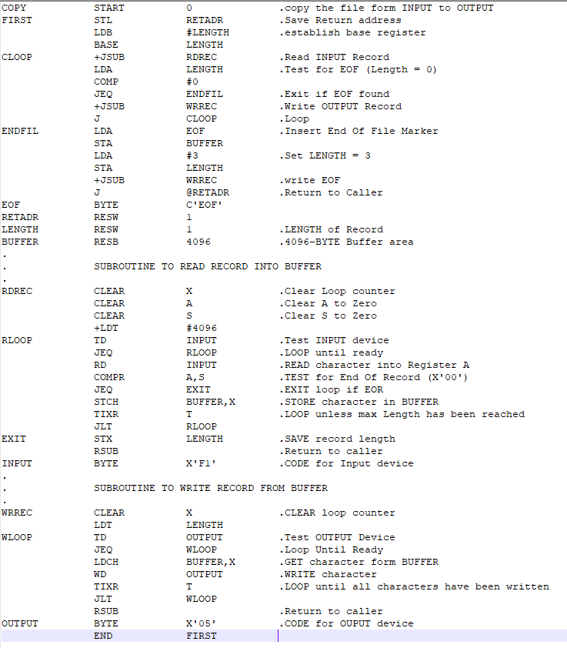
Course Project: functions.txt
This SIC/XE program should look familiar, it is from you book!

Slide 8
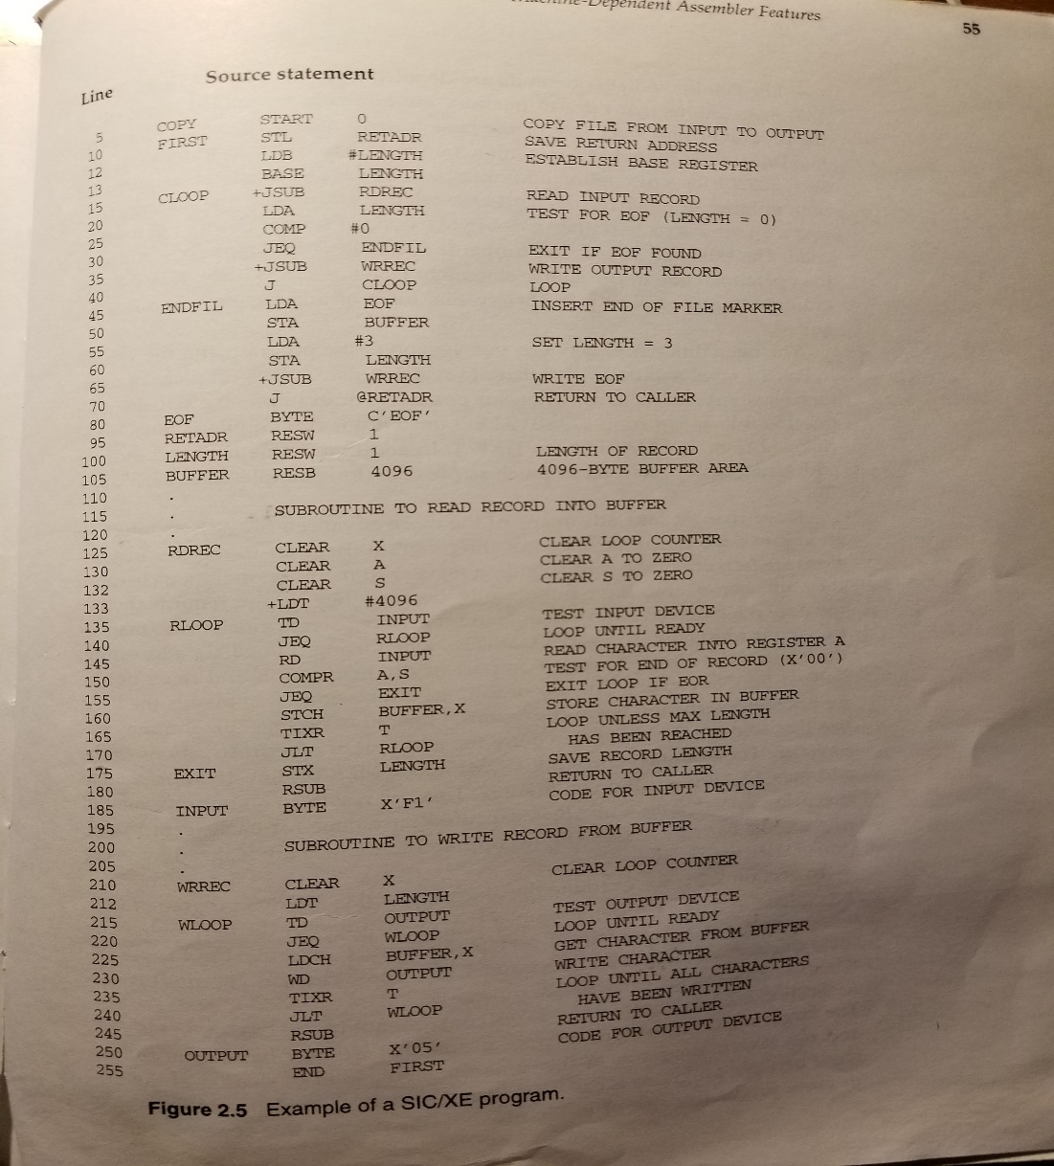
Course Project: functions.txt
functions.txt (pg. 55)

Slide 9
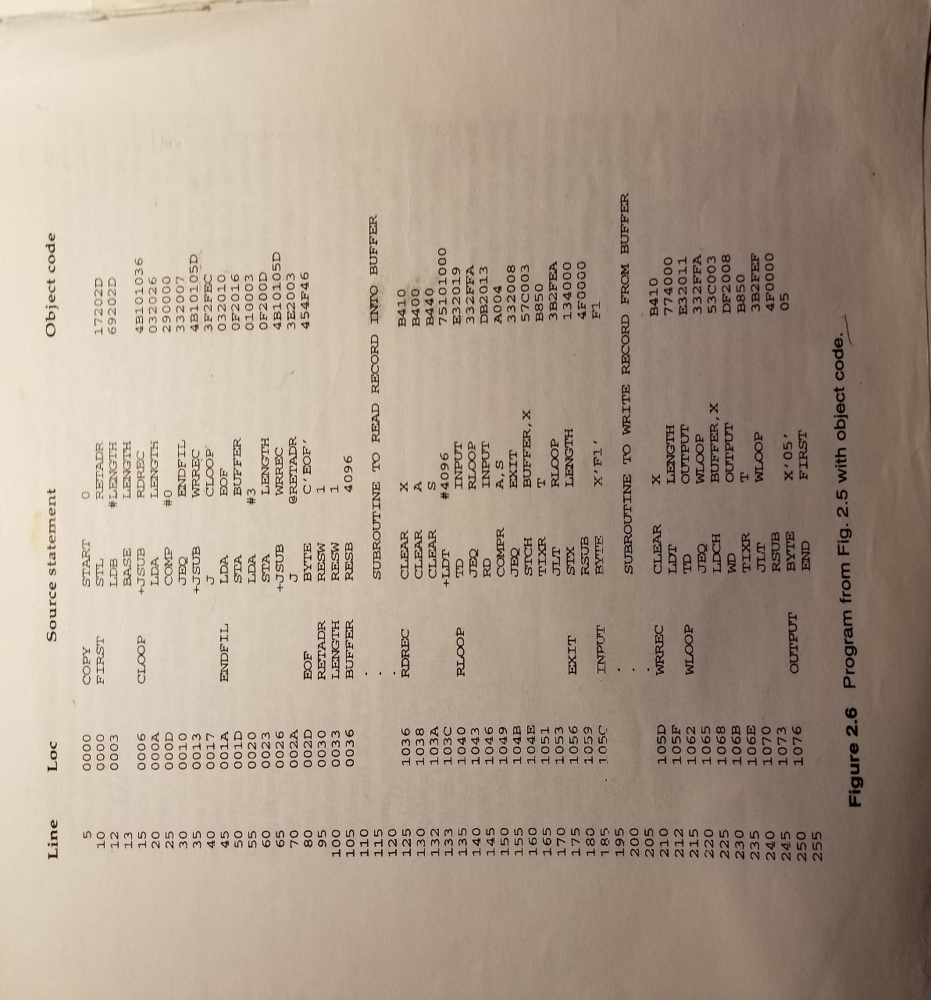
Course Project: functions.txt
functions.txt solution (pg. 58)
Loc and Object Code columns now present!

Slide 10
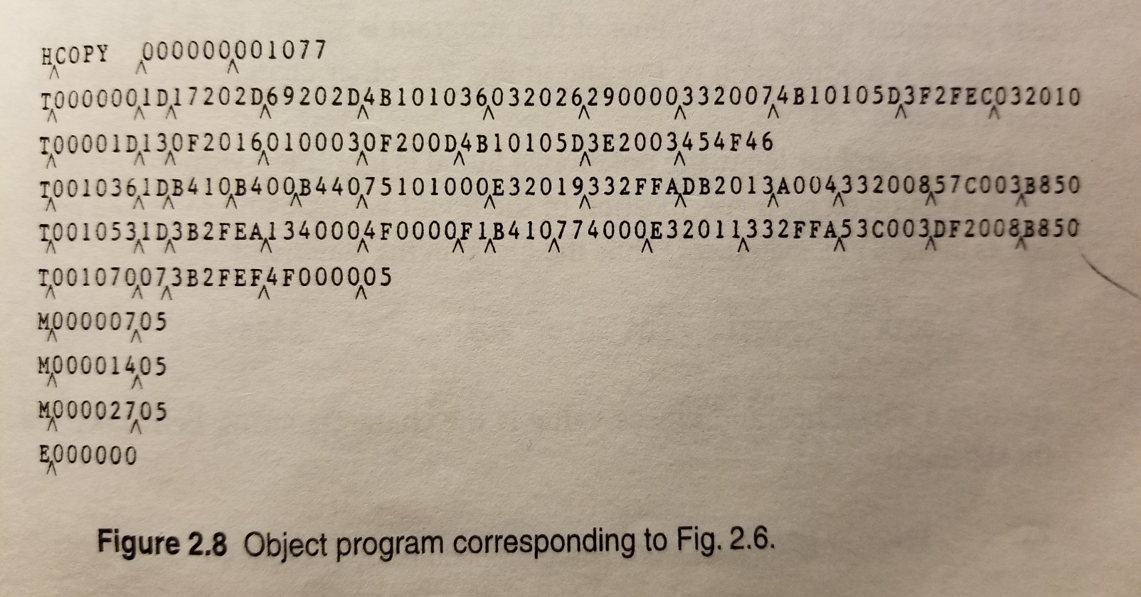
Course Project: functions.txt
functions.txt object program solution (pg. 65)

Slide 11
Course Project: Implementation Details
Cool! We can already see the answers ☺
For many of the sample programs the solutions are given in the book
As you implement your assembler and add functionalities to successfully process each of the six sample programs, you can reference these solutions to see if you are on the right track
This still doesn’t tell us much about how to actually generate the displayed object code or location columns though ☹
Let us try to figure out

Slide 12
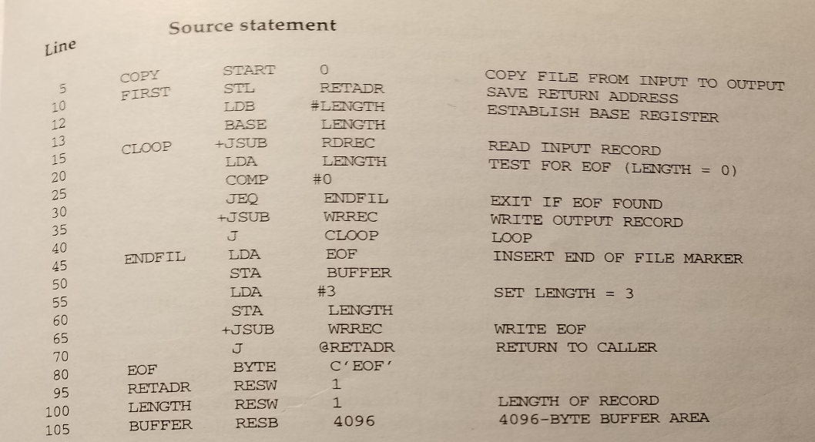

Course Project: Implementation Details
Our given functions.txt file has four tab delimited columns
Symbol Column, Operation Column, Operand Column and Comments Column
Comments are indicated with a ‘.’
In the solution a Loc Coulmn and Object Code Column are added

Slide 13
Course Project: Implementation Details
First we need to perform our assembler’s first pass which will serve mainly to create the Loc Column and Symbol Table (SYMTAB)
The Loc (Location) Column can be created by simply finding the program’s starting address and tracking the amount of bytes that have been used by instructions
How many bytes per instruction?
We will need to use our OPTAB
(we will see what this is in the next slide)
The SYMTAB will keep track of the values
in the Loc Column corresponding to
each symbol in the Symbol Column

Slide 14
Course Project: Implementation Details
Next, we need to perform our second pass in which we generate the Object Code column
Take a second to re-read (or read ☹) 2.2.1 Instruction Formats and Addressing Modes (pg. 57-61) to get an idea of what we will need to do
First we should create an Operation Table (OPTAB)
The OPTAB will contain an entry for each instruction belonging to the SIC/XE instruction set
Each entry should contain the instruction’s corresponding mnemonic, opcode, and format(s)
This information is all given in the back of the book

Slide 15
Course Project: Implementation Details
Once we have the OPTAB, we will use it to determine an instruction’s opcode and format
Then (if necessary) we need to calculate the addressing mode information (nixbpe bits)
Finally (if necessary) we need to calculate the disp/target address information based on the addressing mode information
All this information will be used to calculate the instructions object code
Let us see a few examples

Slide 16
Course Project: Implementation Details
Take a look in functions.txt at this line:
FIRST STL RETADR .SAVE RETURN ADDRESS
First, from our OPTAB we can see STL has an opcode of 14 (hexadecimal) and has a format of 3/4 (3 or 4)
This means the first byte of our opcode will contain the value 14 (0001 0100) plus the n and i bit values we find
This also means we will either have a format 3 or 4 instruction

Slide 17
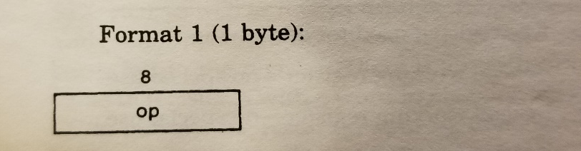
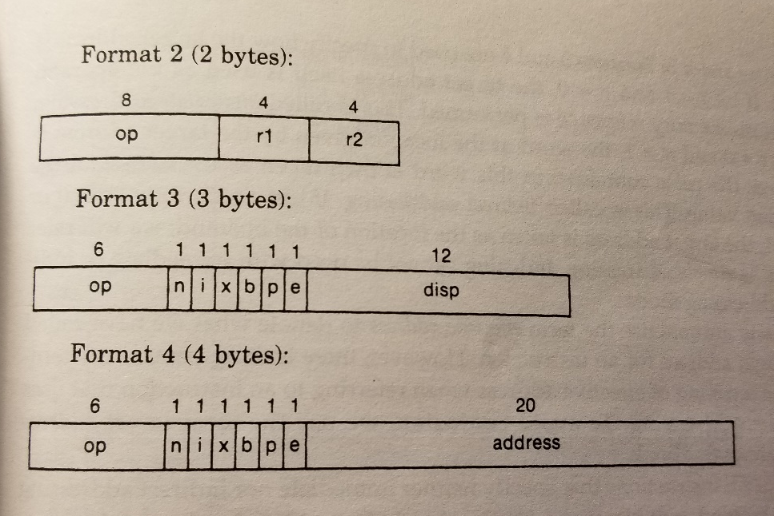
Course Project: Implementation Details
Remember our SIC/XE addressing modes? (pg. 8 and 9)
How can we tell if it is format 3 or 4?

Slide 18

Course Project: Implementation Details
To indicate an instruction is format 4, the instruction will be preceded by a ‘+’
For example, in functions.txt take a look at the +JSUB WRECC line
Since STL has no preceding ‘+’ it must be format 3
So we have the first six bits opcode of our 3 byte format 3 instruction, what about the rest?

Slide 19
Course Project: Implementation Details
Next we need to calculate the nixbpe bits
Remember:
n=1, i=1 indicates simple addressing
We have this by default if we don’t have indirect or immediate addressing
n=1, i=0 indicates indirect addressing
This will be signaled by an operand preceded by a ‘@’
For example, in functions.txt find the J @RETADR line
n=0, i=1 indicates immediate addressing
This will be signaled by an operand preceded by a ‘#’
For example, in functions.txt find the LDB #LENGTH line
x=1 indicates indexed addressing
This will be signaled by an operand followed by ‘, X’
For example, in functions.txt find the STCH BUFFER, X line
b=1, p=0 indicates for base relative addressing
b=0, p=1 indicates for program-counter relative addressing
e=1 indicates a format 4 instruction (e=0 indicates format 3 instruction)

Slide 20
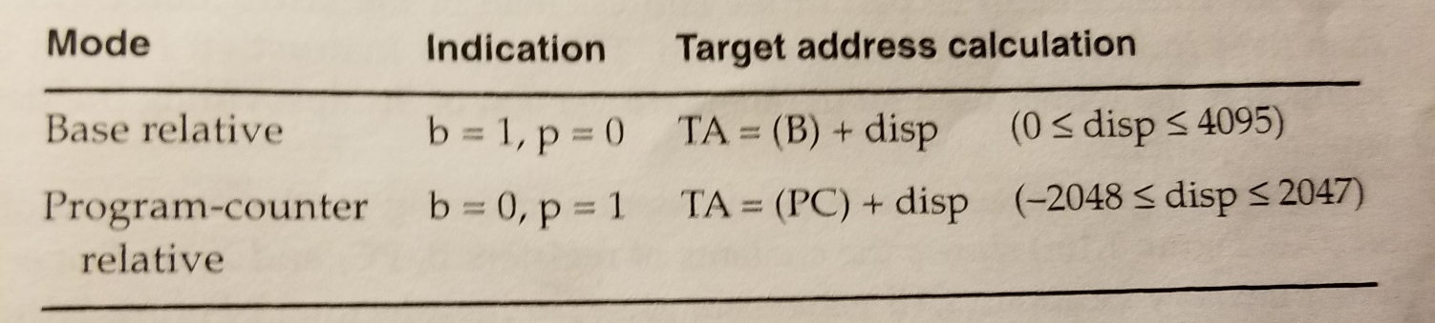
Course Project: Implementation Details
The base relative vs. program-counter relative distinction is a bit harder to discern
In the reading we learned program-counter relative is used by default, but, if the displacement (disp) we calculate is out of range, we resort to base relative

Slide 21

Course Project: Implementation Details
So, in order to see whether we should use program-counter relative or base relative we need to calculate the displacement (disp)
Its been a few slides, remember we are looking at the line:
FIRST STL RETADR .SAVE RETURN ADDRESS
From out first pass, we know this line’s corresponding Loc Column value is 0000
From the reading, we know that the PC register will
contain the next Loc Column value (0003)
We also know from our first pass-generated SYMTAB that the
value corresponding to RETADR is 0030
(this is the target address (TA))

Slide 22
Course Project: Implementation Details
From the book we see, for pc-relative addressing:
TA=(PC)+disp -> disp=TA-(PC)
This means our disp=0030-0003, disp=002D (hexadecimal values)
This is within our program-counter relative disp bounds
(-2048 <= disp <= 2047) (decimal values)

Slide 23
Course Project: Implementation Details
We finally have all the information we need to form the object code for line:
FIRST STL RETADR .SAVE RETURN ADDRESS
op (opcode)=14 or 0001 0100
n=1,i=1,x=0,b=0,p=1,e=0 or 11 0010
We have simple addressing because we didn’t have immediate or indirect addressing!
disp=02D or 0000 0011 1101

Slide 24
Course Project: Implementation Details
FIRST STL RETADR .SAVE RETURN ADDRESS
Object Code Generation:
First byte = opcode + ni -> 0001 0100 + 11 (or 14 + 3) -> 0001 0111 (or 17)
So, our first byte = 0001 0111 (or 17)
Second byte first half = xbpe -> 0010 (or 2)
So, our second byte first half = 0010 (or 2)
Second byte second half and third byte = disp -> 0000 0011 1101 (or 02D)
So, our second byte second half and third byte = 0000 0011 1101 (or 02D)
Altogether, our 3-byte format 3 instruction is:
0001 0111 0010 0000 0011 1101 (or 17202D)

Slide 25

Course Project: Implementation Details

Slide 26
Course Project: Implementation Details
The overall process will be quite similar for format 4 instructions
This process will differ slightly with the different addressing modes
Base relative addressing will require you to keep track of what is loaded into the B register for use in your disp calculation
Immediate and indirect addressing effects also need to be considered!

Slide 27
Course Project: Implementation Details
Let us take a look at a format 2 instruction
Look at functions.txt and find the line:
COMPR A,S .TEST for End Of Record (X'00')
From our OPTAB we see COMPR has opcode of A0 (hexadecimal value) and that it is a format 2 instruction

Slide 28

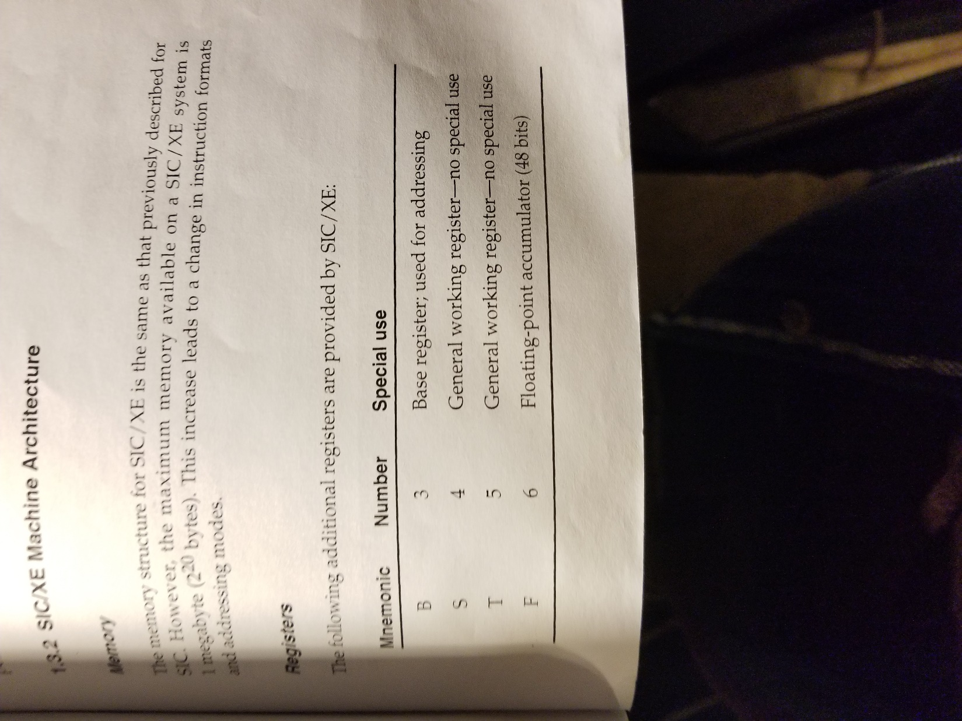
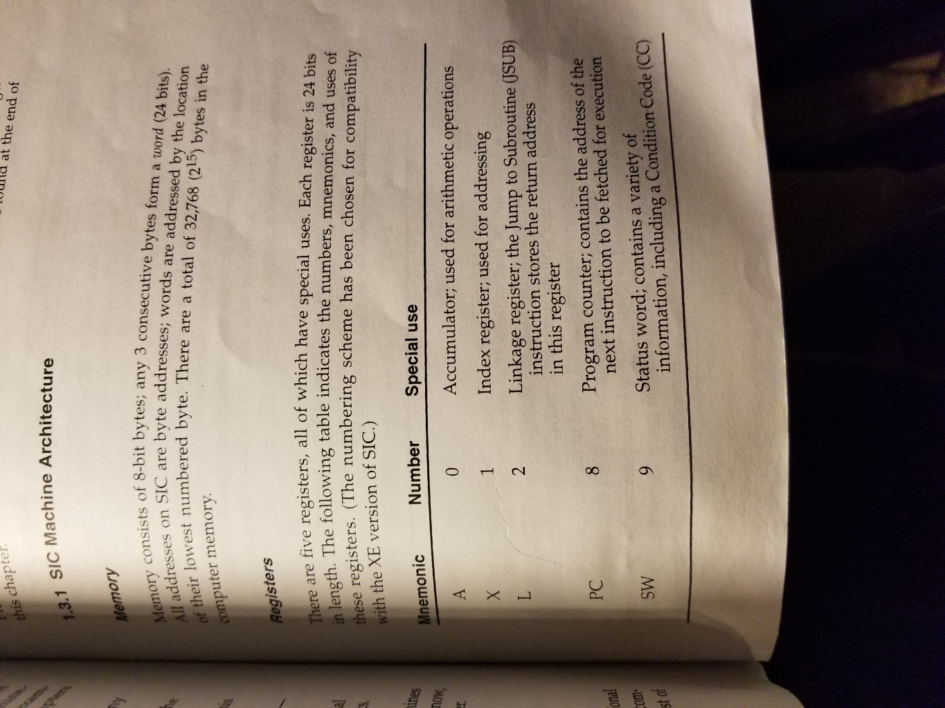
Course Project: Implementation Details
So, we already have the op section ready (A0 or 1010 0000) for the first byte
We need to get the r1 and r2 values for the second byte
The book lists all the register values for us in the first chapter

Slide 29
Course Project: Implementation Details
COMPR A,S .TEST for End Of Record (X'00')
We need the A (0 hexadecimal) and S (4 hexadecimal) register values for r1 and r2 respectively

Slide 30
Course Project: Implementation Details
COMPR A,S .TEST for End Of Record (X'00')
Object Code Generation:
First byte = opcode -> 1010 0000 (or A0)
So, our first byte = 1010 0000 (or A0)
Second byte first half = r1 -> A -> 0000 (or 0)
So, the second byte first half = 0000 (or 0)
Second byte second half = r2 -> S -> 0100 (or 4)
So, the second byte second half = 0100 (or 4)
Altogether, our 2-byte format 2 instruction is:
1010 0000 0000 0100 (or A004)

Slide 31
Course Project: Implementation Details

Slide 32
Course Project: Implementation Details
With each of the sample programs there will need to be added functionality your assembler will need to support
literals.txt adds literals
program-blocks.txt adds program blocks
etc.
You also should create object programs using the object code you generate
I would suggest leaving this part until you can support all six test files
I will leave figuring out these parts to you
Your book is very straightforward and will be your friend as you are figuring out these details
You can come to my office hours and ask me questions

Slide 33
Course Project: Testing
Your assembler should support the six test programs
To test for robustness, your assembler will be tested using files you do not have access to
Good luck and have fun!
Email: phillity@iu.edu
Office Hour: MW 12:30-1:30 SL228

